Slide 1









Travel
Home
Tours Page
News
Contact
World Travel
HIGH CLOUD ANALYSIS
PROJECT
MODULES: EXCEL,SQL,POWER BI &TABLEAU
LET’S GET STARTED
Presented by : Mona, Aswathy S, Jaya Prakash Reddy, Farithul Aslam,Aelugu Navya,R.Sri Ramyutha,Mohammed Farid
Page |
01.
1

Slide 2




Travel
Home
Tours Page
News
Contact
TABLE OF CONTENTS
1
INTRODUCTION
2
KEY PERFORMANCE INDICATORS(KPIS)
3
SQL QUERIES AND RESULTS
4
EXCEL DASHBOARD
5
POWER BI ANALYSIS
6
TABLEAU VISUALIZATION
7
ACHIEVEMENTS
8
CHALLENGES FACED
9
CONCLUSION
10
THANKYOU
Page |
02.
2

Slide 3








Travel
Home
Tours Page
News
Contact
PROJECT OVERVIEW & OBJECTIVES
HIGHCLOUDS AIRLINES (2008-2013) HIGHLIGHTS INCLUDE 187M PASSENGERS, 8B FREIGHT UNITS, AND PEAK DEMAND IN JULY WITH AN 82% LOAD FACTOR. JANUARY AND FEBRUARY UNDERPERFORMED, SUGGESTING OPPORTUNITIES FOR PROMOTIONS AND COST-SAVING MEASURES. KEY ROUTES (E.G., ATLANTA → NEW YORK) AND TOP FREIGHT CARRIERS (FEDEX, UPS) OFFER POTENTIAL FOR STRATEGIC GROWTH AND OPTIMIZATION. IN BELOW SLIDES WE WILL SEE IN DETAILS.
The objective of the project is to provide actionable insights while also conducting an analysis of key performance metrics.
In order to accomplish eight different tasks with a single tool and offer insights, we began with Excel and SQL, then moved on to Power BI and Tableau in subsequent weeks.
Page |
03.
3

Slide 4


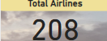

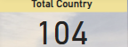

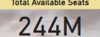
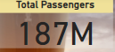
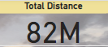
Travel
Home
Tours Page
News
Contact
OVERALL STATISTICS
The KPI of 208 total Airlines represents the total number of airlines operating under Highclouds Airlines between 2008 and 2013, reflecting the extensive network and operational scale of the airline.
With 111,000 departures performed, the 208 total airlines collectively demonstrate Highclouds Airlines' extensive operational activity between 2008 and 2013.
Highclouds Airlines operated in 104 countries, offering extensive global connectivity with 244 million available seats, 111,000 departures, and 82 million miles traveled between 2008 and 2013.
Highclouds Airlines operated across 104 countries, offering 244 million available seats through 111,000 departures between 2008 and 2013.
Highclouds Airlines transported 187 million passengers across 104 countries, offering 244 million available seats through 111,000 departures between 2008 and 2013.
Highclouds Airlines covered a total distance of 82 million miles, transporting 187 million passengers across 104 countries with 244 million available seats and 111,000 departures between 2008 and 2013.
Page |
04.
4

Slide 5

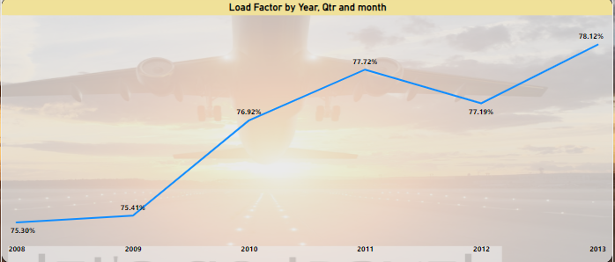
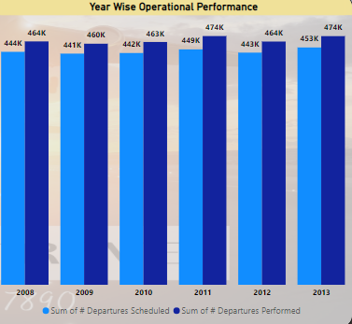
Travel
Home
Tours Page
News
Contact
Year and month wise analysis
The load factor steadily increased from 75.30% in 2008 to 78.12% in 2013, showing consistent growth in passenger seat utilization. Peaks occurred in 2011 (77.72%) and 2013, indicating effective demand management.
Top Month: July (82% load factor for 4 consecutive years)Lowest Month: January (67% in 2008 & 2009)
The operational performance shows a steady increase in both scheduled and performed departures from 2008 to 2013, with 474K departures performed in the final year. The close alignment of scheduled and performed departures reflects efficient planning and execution.
Page |
05.
5
Notes:
5

Slide 6
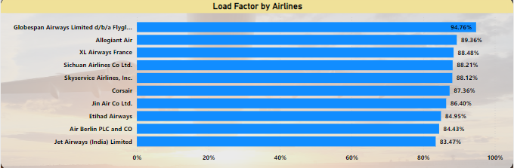
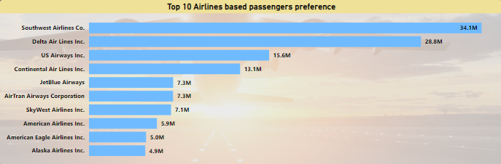
Travel
Home
Tours Page
News
Contact
Airlines Analysis by passenger and Load Factor
The top three airlines by load factor are Globespan Airways (95%), Allegiant Air (89%), and XL Airways France (88%), demonstrating exceptional efficiency in filling available seats.
The top three airlines by passenger volume are Southwest Airlines (34M ), Delta Airlines (29M), and US Airways Inc. (16M), highlighting their significant market share and operational scale.
Page |
06.
6
Notes:
6

Slide 7
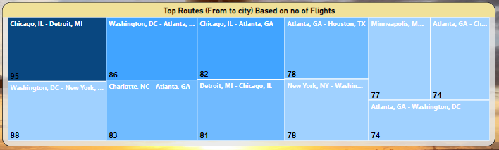
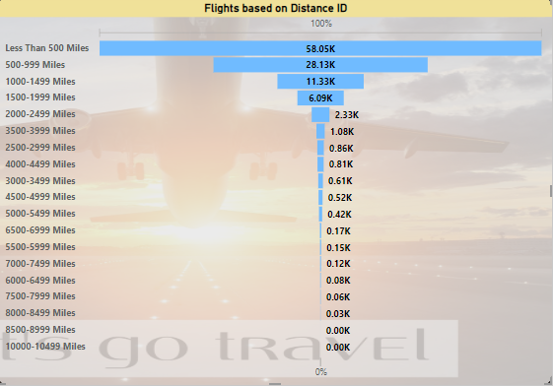
Travel
Home
Tours Page
News
Contact
Routes And Distance Insights
The top route by the number of flights is Chicago, IL ↔ Detroit, MI (95 flights), while the top route by volume is Atlanta → New York, achieving an impressive 80% load factor
Recommendations Focus on maintaining high service quality for these key routes. Use insights from high-performing routes to improve underperforming ones.
Departures performed for distances less than 500 miles total 58,000, while those between 500-999 miles account for 28000, reflecting a significant focus on short to medium-haul routes. And there are Flights above 10000 Miles.
Page |
07.
7
Notes:
7

Slide 8
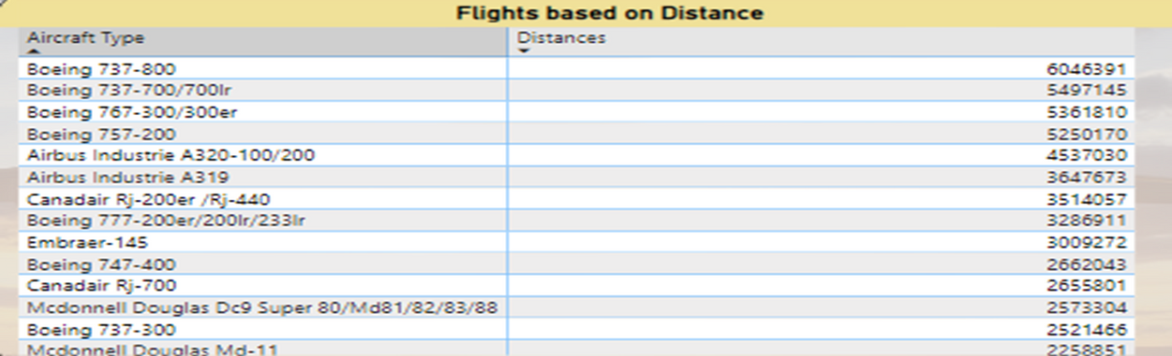
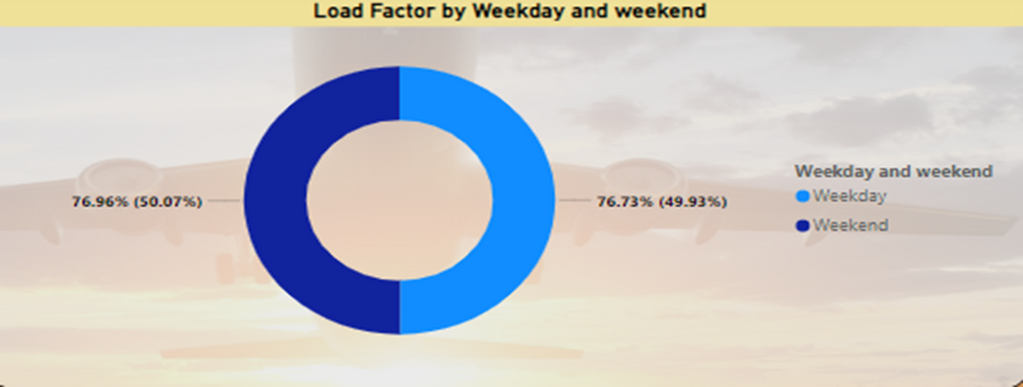
Travel
Home
Tours Page
News
Contact
Distance and Load Factor Insights
The Boeing 737-800 leads in usage with 6,046,391 operations, followed by the Boeing 737-700/700LR at 5,497,145 and the Boeing 737-300/300ER at 5,361,810, highlighting their prominence in the fleet for operational efficiency.
The load factor on weekends is higher at 76.73% compared to weekdays, which stand at 76.96%, indicating stronger passenger demand during weekends.
Page |
08.
8
Notes:
8

Slide 9


Travel
Home
Tours Page
News
Contact
KPIS OVERIEW
Load Factor: Measured the percentage of available seats filled by passengers, highlighting efficiency in seat utilization.
Passenger Volume: Tracked the total number of passengers transported, providing insights into the airline's market share and operational scale.
Route Performance: Evaluated key routes by volume, efficiency, and the number of flights, helping identify high-demand and profitable routes.
Aircraft Utilization: Monitored the number of flights performed by various aircraft types, such as Boeing 737-800 (6M flights), to assess fleet efficiency.
Distance-Based Departures: Analyzed flights by distance categories (e.g., <500 miles: 58K, 500-999 miles: 29.13K), offering insights into operational focus on short or medium-haul routes.
Departure Performance: Compared scheduled vs. performed departures, ensuring alignment with operational goals.
Day-Based Load Factor: Assessed load factors for weekends (76.96%) vs. weekdays (76.73%) to optimize scheduling.
Airline Efficiency: Highlighted top-performing airlines by load factor (e.g., Globespan Airways: 95%) and passenger volume (e.g., Southwest Airlines: 34M).
Camping
Fishing
Page |
09.
9

Slide 10

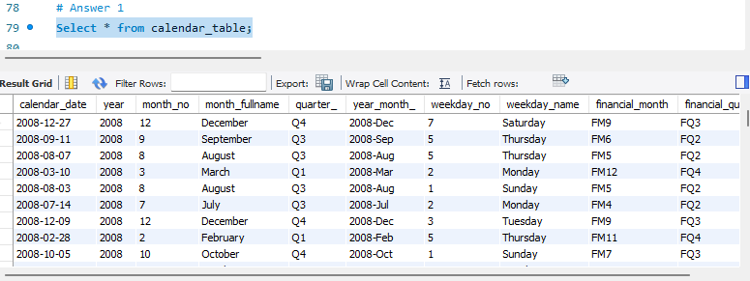
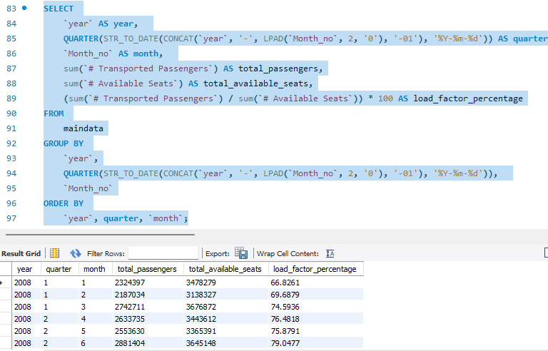
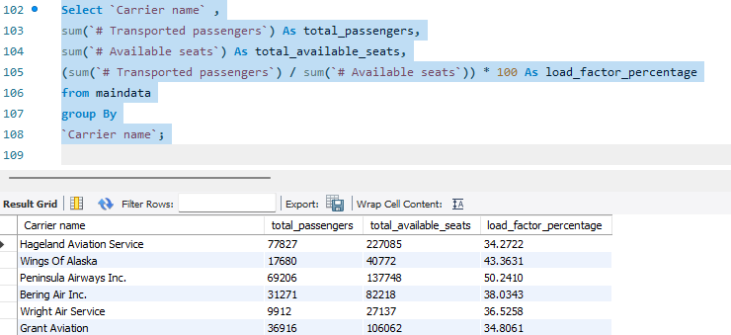
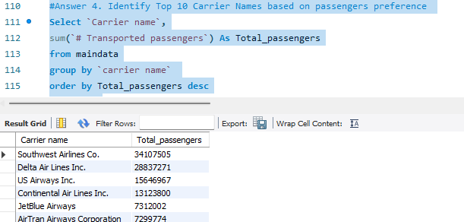
Travel
Home
Tours Page
News
Contact
SQL Query for KPI
Page |
10.
10

Slide 11


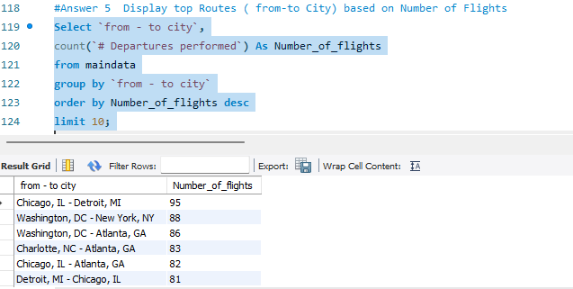
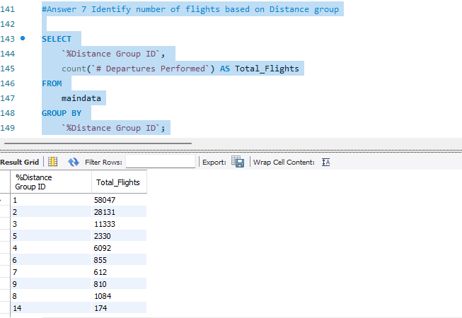
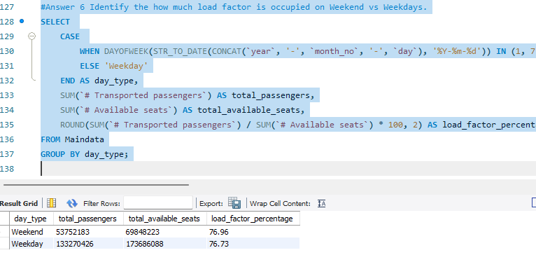
Travel
Home
Tours Page
News
Contact
SQL Query for KPI
This Query helps us calculates the total passengers transported, flights performed, and distance covered per airline, route, or category over a specified time period (e.g., the last quarter). It aggregates data from flight operations, grouping by airline, route, or distance category (such as short-haul, medium-haul, or long-haul), and provides insights into the performance of airlines and routes. This helps evaluate operational efficiency, passenger trends, and market demand across the airline network.
Page |
11
11

Slide 12
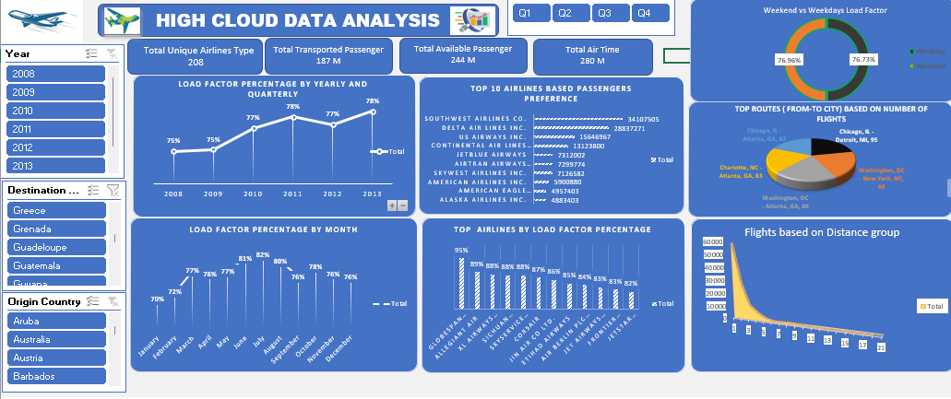
Travel
Home
Tours Page
News
Contact
Excel Dashboard
An Excel dashboard for airline operations consolidates key metrics such as total passengers transported, load factors, flight performance, and route efficiency into a single, intuitive visual interface. Using Pivot Tables, formulas, and charts, this dashboard allows users to analyze passenger trends, route performance, fleet utilization, and operational efficiency, enabling informed decision-making and strategic optimization.
Page |
12
12

Slide 13
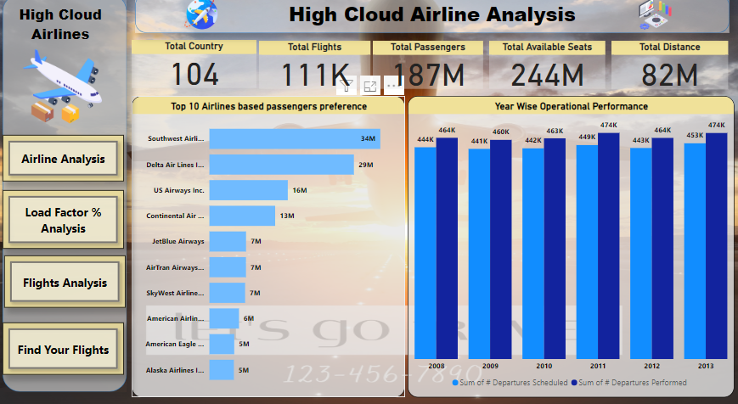
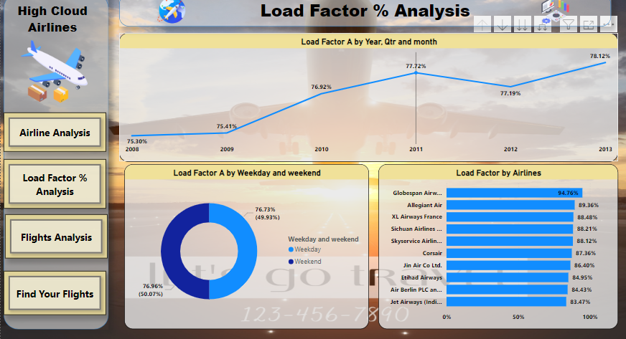
Travel
Home
Tours Page
News
Contact
Power BI Dashboard
Page |
13
13

Slide 14
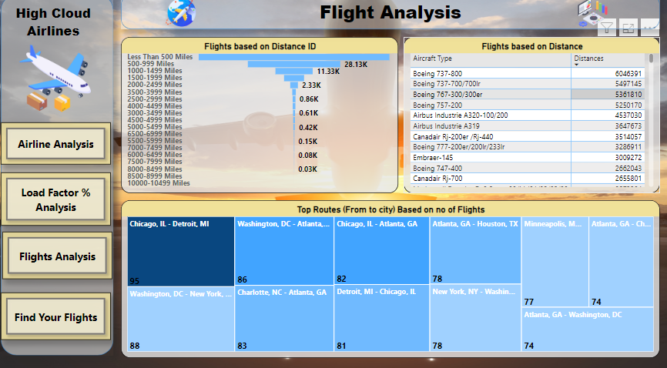
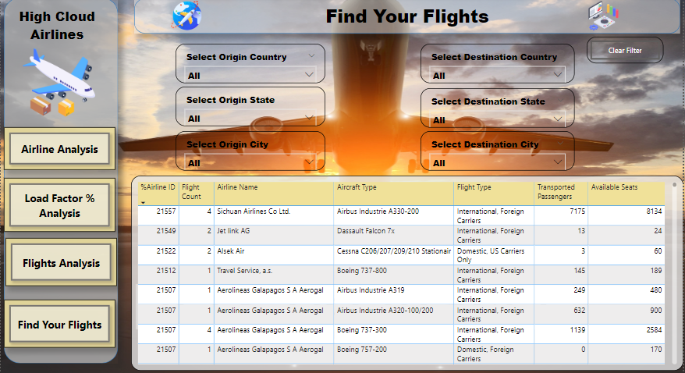
Travel
Home
Tours Page
News
Contact
Power BI Dashboard
A Power BI dashboard for airline operations integrates critical metrics such as passenger volume, load factors, flight performance, and route efficiency into an interactive and visually engaging platform. Featuring dynamic charts, maps, and filters, the dashboard empowers users to explore passenger trends, evaluate route and fleet performance, and monitor operational efficiency, facilitating strategic insights and data-driven decision-making.
Page |
14
14

Slide 15
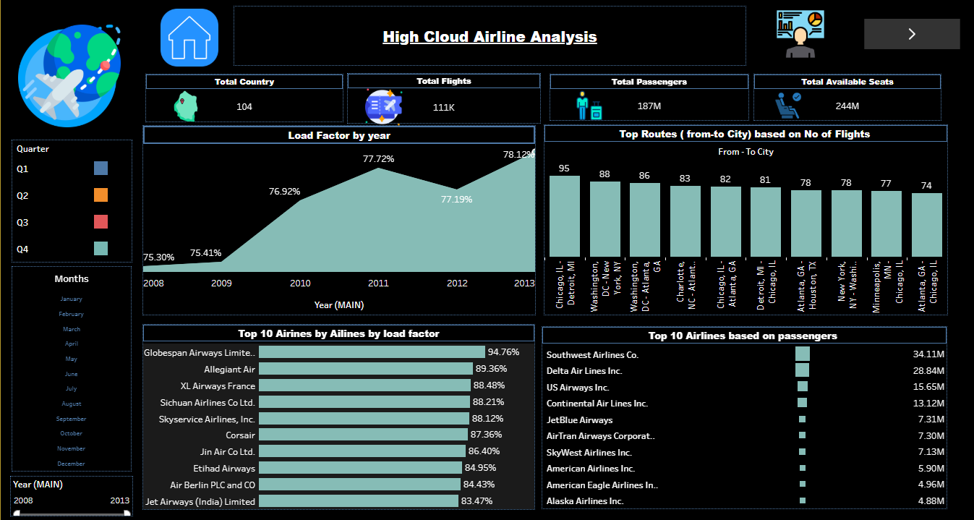
Travel
Home
Tours Page
News
Contact
Tableau Dashboard
Page |
15
15

Slide 16
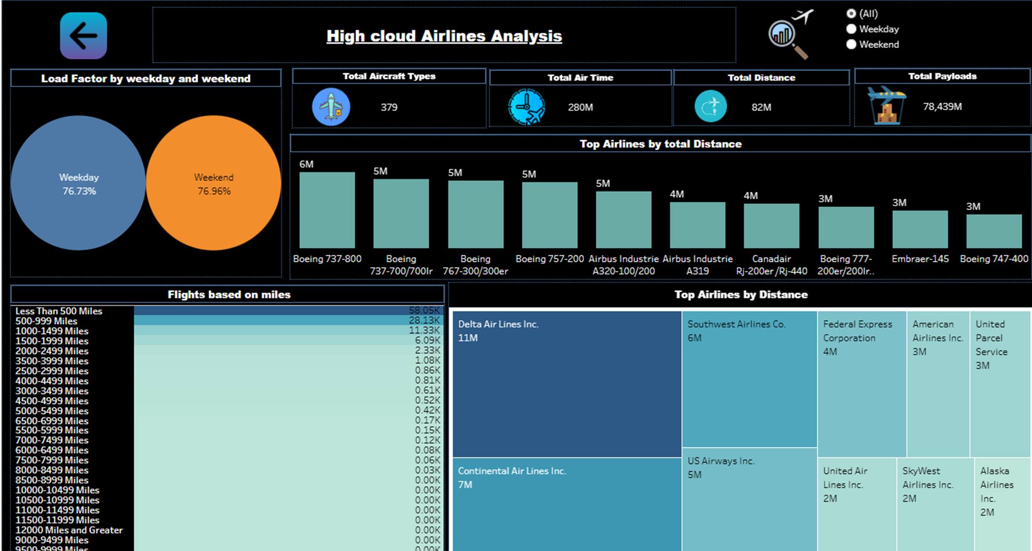
Travel
Home
Tours Page
News
Contact
Tableau Dashboard
A Tableau dashboard for airline operations presents key metrics such as passenger volume, load factors, flight performance, and route efficiency through an interactive and visually rich interface. Using dynamic visualizations like heat maps, bar charts, and filters, the dashboard enables users to analyze trends, evaluate route performance, and monitor operational efficiency, providing actionable insights for strategic planning and optimization.
Page |
16
17

Slide 17








Travel
Home
Tours Page
News
Contact
AIRLINES
ACHIEVEMENT.
187M
82M
Happy Travelers
Total Distance
111K
280
Total Flights
Total Airtime
Page |
17.
17

Slide 18





Travel
Home
Tours Page
News
Contact
CHALLENGES ENCOUNTERED
Technical Challenges
Solutions/
Workaround
SQL Data Loading Errors: We encountered issues while loading data from the SQL database due to data structure was huge and slow query execution.
This was resolved by optimizing SQL queries and cleaning the data before import.
We fixed this by reconfiguring the slicers to properly connect to the relevant data, restoring full functionality.
The slicers were not filtering data correctly due to mis linked fields in the data model
Page |
18
18

Slide 19

Travel
Home
Tours Page
News
Contact
CONCLUSIONS AND KEY TAKEAWAYS
These insights enabled more informed decision-making on resource allocation, route optimization, and scheduling strategies, helping to enhance operational efficiency, improve passenger satisfaction, and drive future growth in airline performance.
Next steps include refining route strategies, optimizing flight schedules, enhancing fleet utilization, and improving operational forecasting to drive future airline performance and efficiency.
The project findings will guide future decisions by enabling targeted marketing for high-demand routes, optimizing schedules based on passenger trends, enhancing fleet utilization, and improving operational forecasting. These insights will help maximize efficiency, improve resource allocation, and boost overall airline performance.
SUMMARY OF FINDINGS
FUTURE RECOMMENDATIONS
IMPACT OF THE PROJECT
Page |
19
19

Slide 20




Travel
Home
Tours Page
News
Contact
World Travel
THANKS FOR
WATCHING.
Page |
20
20

